Slide 1


Investigating the effects of impermeant anions and electrodiffusion on the electrical and computational properties of neurons
Eran Shorer
Supervised by Dr. Joseph Raimondo
MSc(Med)Neuroscience
Research proposal presentation
UCT Division of Cellular, Nutritional and Physiological Sciences
Notes:
Hello everyone. My name is Eran Shorer and I am doing an MSc in Neuroscience under the supervisor of Dr. Joe Raimondo. Today I’ll be presenting my research proposal titled: “Investigating the effects of impermeant anions and electrodiffusion on the electrical and computational properties of neurons”

Slide 2
Outline
Background
Neural modelling
Limitations of current models
Why does this matter?
Aims and hypotheses
Notes:
Ill start off by giving a bit of background to myself and then move forward to discuss computational modelling of neurons, where they go wrong, what is the impact of this, and how I’ll go about trying to create a new model.

Slide 3
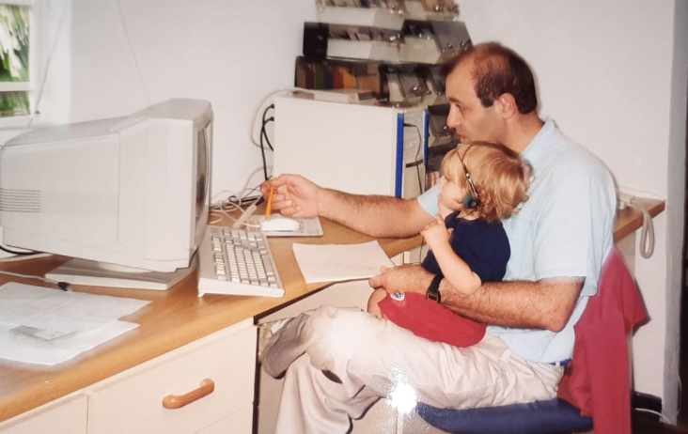

Where I come from
24 years of coding experience
MBChB (UCT)
Intercalated BSc(Med)Hons Neurophysiology
IBRO SIMONS Computational Neuroscience Imbizo
Notes:
As a child I have always been drawn to computers and was exposed to it from a young age seeing as my dad was a computer engineer. My mom however is a medical doctor and I ultimately ended up following in her footsteps. I have recently qualified as a medical doctor from UCT. During my years at med-school I completed a BSc Honours degree in Neurophysiology where I built a mathematical model that predicted which subset of patients would likely improve after cognitive training.
What drew me into this project specifically was my time spent at the IBRO computational neuroscience Imbizo which took place at Muizenberg for 3 weeks in January this year.
At the summer school I met Chris Currin and worked with him on his own Neural modelling work that he did with Joe and Kira.
I really enjoyed the project and thankfully Joe mentioned that he would like to extend some of the work done by Chris and Kira, so I jumped at the opportunity to do so.
I first was exposed to neural modelling at the IBRO computational neuroscience imbizo at Muizenberg. I worked on a project with Chris and really enjoyed thinking about and programming neurons in python. Also seeing Chris’ cool figures and stuff made me want to learn more.
Thankfully after speaking to Joe he mentioned that there is an opportunity to extend some of the models that Chris and Kira worked on. I obviously jumped at the opportunity so

Slide 4
Take away message
Computational models of neurons provide unique insights
Current models assume fixed resting membrane voltages (isopotentiality) and don’t account for impermeant anions
These limitations impact our understanding of normal and disease states
Electrodiffusion based models incorporating impermeant anions may help address this problem
Notes:
Before we begin I’d like to discuss some of the end points that I want you to gain by the end of the talk. Some of these topics may not seem too familiar because we have a diverse audience but I will go through each section slowly, and please feel free to ask questions if there is something that you don’t understand.

Slide 5
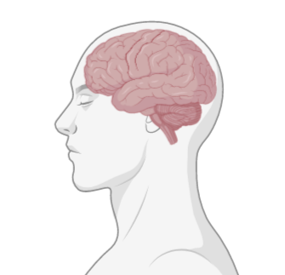

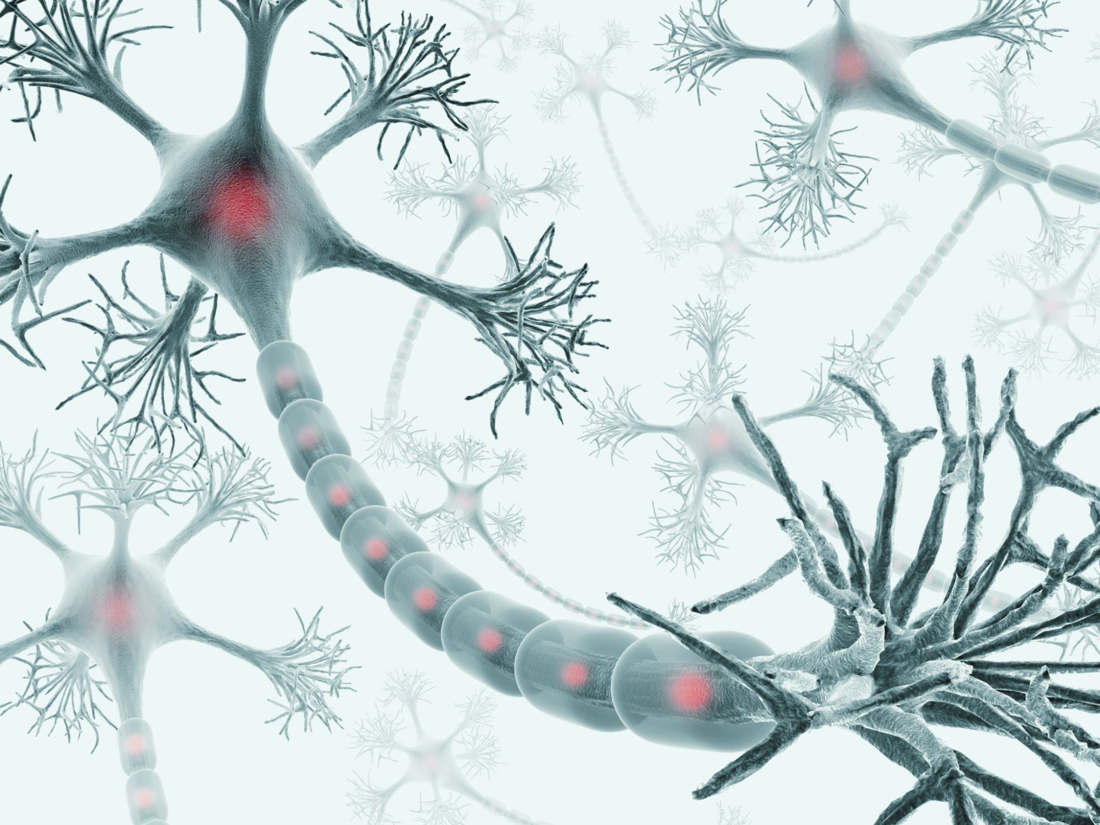

Computational Neuroscience
Input
Processing
Brains ~ computers
Output
Neurons ~ semiconductors
Notes:
The brain does indeed perform computations like a computer. The brain has units in networks (neurons instead of semiconductors) that take in and compile data, operate on the data, and generate output.

Slide 6
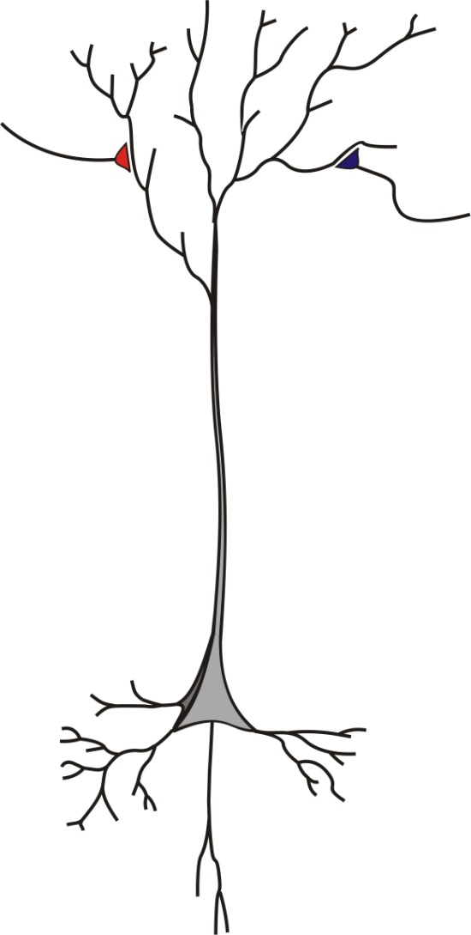
Neural signalling
Neurons compute by integrating excitatory and inhibitory synaptic input.
Input
Neurons are the fundamental computational unit of the brain
Processing
Output

Slide 7
Neural signalling
Neurons compute by integrating excitatory and inhibitory synaptic input.
Input
Synapses provide input to the neuron

Slide 8
Neural signalling
Neurons compute by integrating excitatory and inhibitory synaptic input.
Processing
Processing of inputs occurs in the dendrites and cell body
Notes:
An example of processing occurs when two signals are added together in the dendrite

Slide 9
Neural signalling
Neurons compute by integrating excitatory and inhibitory synaptic input.
Output
Outputs are communicated via axons

Slide 10
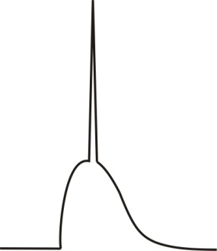





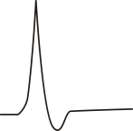

Neural signalling
Neurons compute by integrating excitatory and inhibitory synaptic input.
+
=
-70 mV
+
=
-70 mV
Notes:
Here I will go into a bit more detail into what is meant by the input, processing and output.
As mentioned inputs can either be excitatory or inhibitory.
When an excitatory synaptic input occurs on a dendrite there is an upward deflection, or increase in the membrane voltage in the dendrite.
Conversely when an inhibitory input occurs there is a downwards deflection, or decrease in membrane voltage.
These inputs can be added together to form even greater upward deflections or when an excitatory and inhibitory input co-occur there can be a no net change in the membrane potential.
If the sum of the inputs at the beginning of the axon is greater than a certain threshold (usually around -55mV), an output in terms of an action potential fires down the axon.

Slide 11

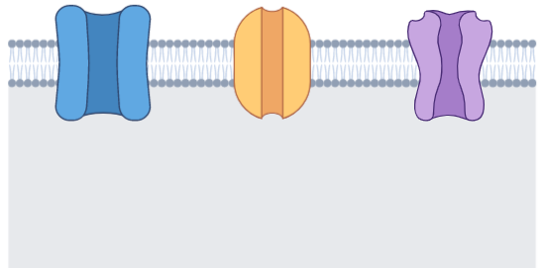
Neural signalling
Neurons compute by integrating excitatory and inhibitory synaptic input.
-65mV
Na +
Cl-
K +
Notes:
This schematic simply depicts what is actually happening at the synapse and what we are measuring

Slide 12

Ionic movement
Neurons compute by integrating excitatory and inhibitory synaptic input.
Diffusion: Ions move down concentration gradients
Extracellular space
Intracellular space
+
+
+
+
+
+

Slide 13
Ionic movement
Neurons compute by integrating excitatory and inhibitory synaptic input.
Drift: Ions move down electrical gradients
Extracellular space
Intracellular space
+
-
-
+
-
-
+
+

Slide 14
Ionic movement
Neurons compute by integrating excitatory and inhibitory synaptic input.
Ionic reversal potential is the voltage at which there is no net movement for a particular ion
-65mV
Extracellular space
Intracellular space
+
-
-
+
-
-
+
+

Slide 15
Outline
Background
Neural modelling
Limitations of current models
Why does this matter?
Aims and hypotheses
Notes:
* Make fancy transitions

Slide 16

Neural modelling
Why model neurons computationally?

Slide 17
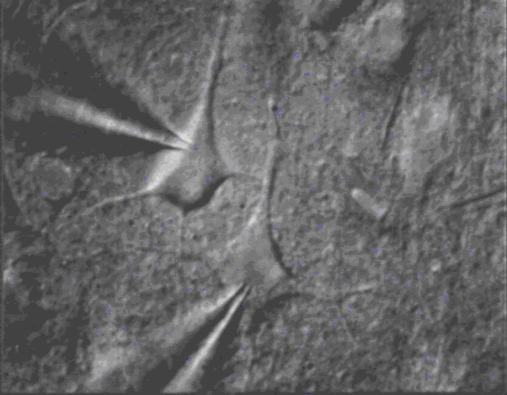
Neural modelling
Why model neurons computationally?
Cross validate experimental findings
Limitations of experimental methods
Saving time and money
Notes:
Clearly explain limitations of experimental methods:
For experimentalists it is useful to have computational models because by developing a similar theoretical setup, they can refute or confirm some of their experimental findings.
Experimentation is hard. In cellular neuroscience the techniques to have a look inside the cell are difficult to master and one is simply unable to accurately record the voltages from many areas of the neuron simultaneously. It is even hard to track the concentrations of ions moving in and out of the cell and measuring the volume changes in real time.
Often doing experimental work can take a lot of time to train at the various techniques and performing experimental methods requires lab resources. Therefore time and resources can be saved by adopting computational approaches.

Slide 18
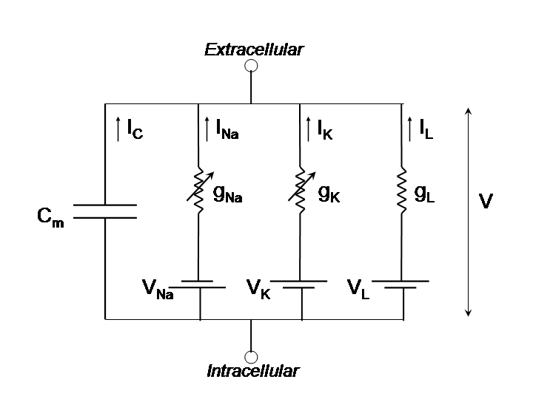
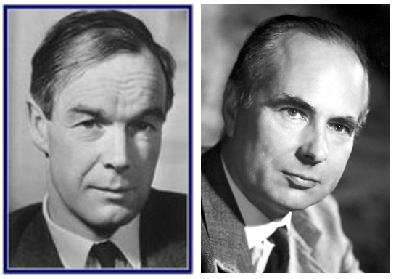
Neural modelling
Equivalent circuit models
Nobel Prize in Physiology awarded to Hodgkin and Huxley in 1963
Alan Hodgkin
Andrew Huxley
Notes:
The most prominent computational descriptions of neurons were created by Alan Hodgkin and Andrew Huxley. They created the equivalent circuit model where each cellular component is likened to an electronic component in an electrical circuit. For instance, the cell membrane acts as a capacitor while ion channels are considered resistors. Using this model they were able to make theoretical predictions which matched experimental models in large neurons. For this work they were awarded the nobel prize in physiology in 1963.

Slide 19
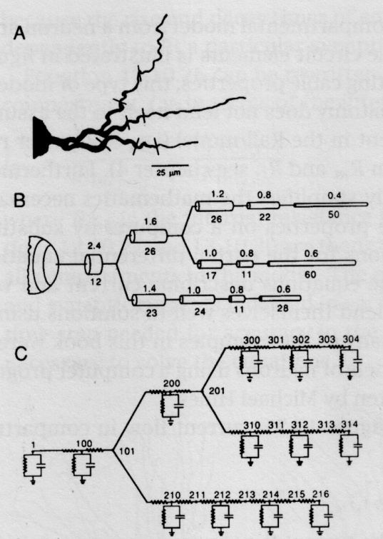
Neural modelling
Compartments
Cable Theory
Notes:
The Hodgkin Huxley model was further developed by Rall who incorporated the spatial aspects of neurons into the model. In picture A we can see a dendrite. In B the morphology of the dendrite is broken up into distinct compartments. And in C each compartment is likened to a Hodgkin Huxley Circuit.

Slide 20
Outline
Background
Neural modelling
Limitations of current models
Why does this matter?
Aims and hypotheses

Slide 21
Limitation 1
Limitation 1 -Traditional models consider ionic reversal potentials to be constant, which results in isopotential neurons
Ionic reversal potential is the voltage at which there is no net movement for a particular ion
Notes:
At rest

Slide 22
Limitation 1
Limitation 1: Constant ionic reversal potentials
+62mV
+62mV
+62mV
Sodium ion
Na +
Notes:
* Make fancy transitions

Slide 23
Limitation 1
Limitation 1: Constant ionic reversal potentials
-80mV
-80mV
-80mV
Potassium ion
K +
Notes:
* Make fancy transitions

Slide 24
Limitation 1
Limitation 1: Constant ionic reversal potentials
-65mV
-65mV
-65mV
Chloride ion
Cl-
Notes:
* Make fancy transitions

Slide 25
Isopotential neurons
Isopotential = constant membrane potential across all compartments
-65mV
-65mV
-65mV
Na +
Cl -
K +
Notes:
The implication of this is that Cable Theory assumes that the neuron is isopotential – that is having the same membrane voltage in each compartment.
In large neurons, like the ones studied my Hodgkin and Huxley this is true, and the assumption of isopotentiality doesn’t make much difference in the models predictions.
However, in small spaces where there are rapid changes in ionic concentrations this is not the case.

Slide 26
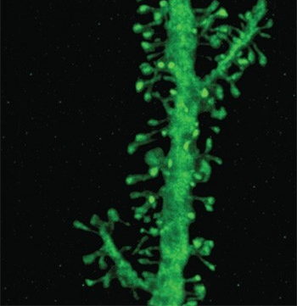
Non-isopotential neurons
In areas of rapid ionic change (e.g. dendritic spines) the assumption of constant ionic reversal potentials is incorrect
-65mV
-65mV
Dendritic Spines
Notes:
Dendritic spines are pedunculations off dendrites which are mainly responsible for excitatory synaptic input. These are nanometers in diameter and ions cross the membrane in nanosecond time scales.
If we consider the spine in picture to consist of 2 compartments, we can see that the changes in 1 compartment is not equal to the changes seen in the second compartment.

Slide 27
Non-isopotential neurons
In order to test the assumption of non-isopotential neurons, electrodiffusion based models are needed
Electrodiffusion incorporates both diffusion and drift in real time
+
-
+
-
Notes:
To test this theory of non-isopotentiality we need an electrodiffusion based model which can track the movement of ions across individual compartments and between compartments

Slide 28
Limitation 2
Limitation 2 -Traditional models don’t account for impermeant anions
Notes:
At rest

Slide 29
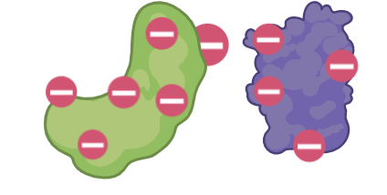
Impermeant anions
Anions are negative charged molecules
Impermeant anions are a subset of anions which exist intracellularly and extracellularly but can’t traverse the cell membrane
Examples of impermeant anions include: proteins; metabolites; nucleic acids
I -

Slide 30
Impermeant anions
Extracellular space
Intracellular space
Na +
K +
I -
I -

Slide 31
Outline
Background
Dendritic modelling
Limitations of current models
Why does this matter?
Aims and hypotheses
Notes:
* Make fancy transitions

Slide 32
Why does this matter?
Limitation 1:
Rapid ionic fluxes occur in cortical spreading depression and epilepsy. In these instances neurons may be non isopotential
Limitation 2:
Impermeant anions help regulate cell volume and promote cerebral swelling after strokes
Impermeant anions are a hallmark of neurodegenerative disorders such Alzheimer’s and Parkinson’s Disease

Slide 33
Outline
Background
Dendritic modelling
Limitations of current models
Why does this matter?
Aims and hypotheses
Notes:
* Make fancy transitions

Slide 34
Aim
To develop a biophysically plausible computational multicompartmental neuronal model incorporating electrodiffusion.
Using this model to investigate the influence of impermeant anions on the electrical and information processing properties of neurons.

Slide 35
Objective 1
1) To develop a computational tool to dynamically model ion homeostasis, volume regulation and electrical changes that occur within a neuron
Create a single compartmental model
Create a multicompartmental model incorporating the properties of diffusion and electrical drift
Create a tool to visualize the changes to the ionic concentrations, electrical properties and cell volume within each compartment as these properties vary with time

Slide 36
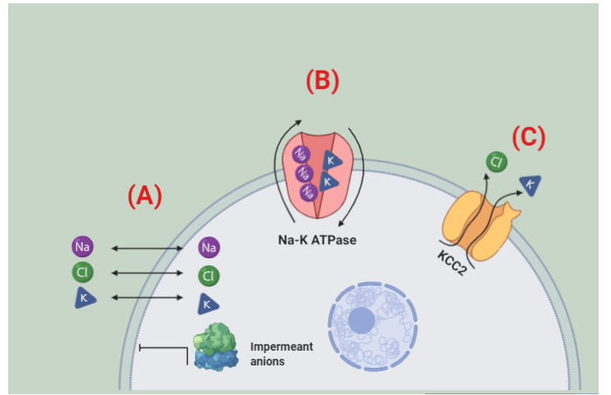

Objective 1a – single compartment model
“Na-K ATPase regulates cell volume”

Slide 37
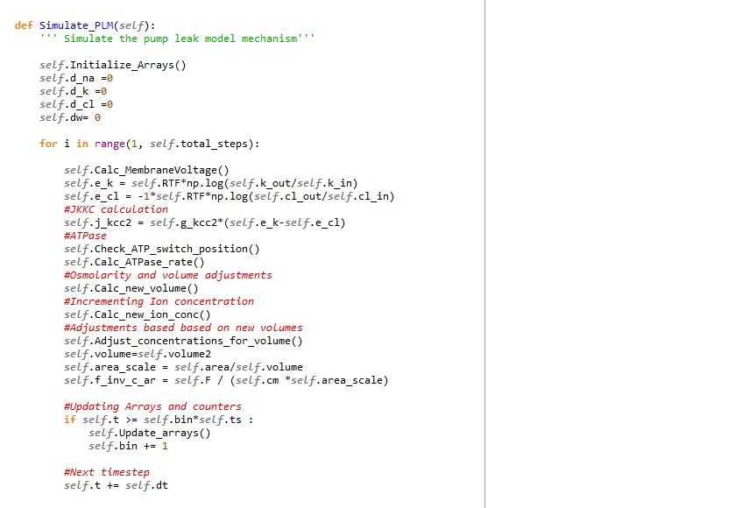
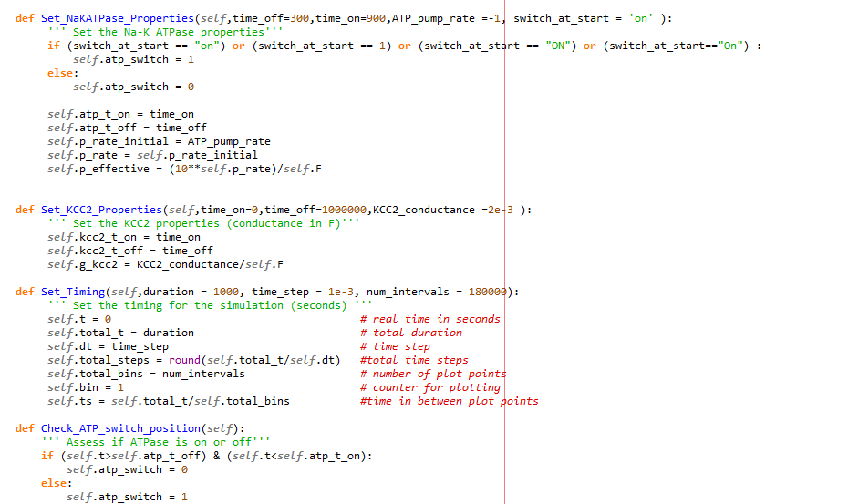
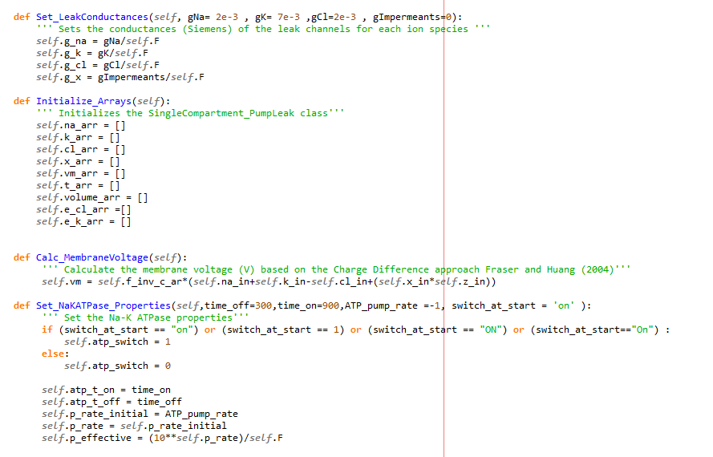
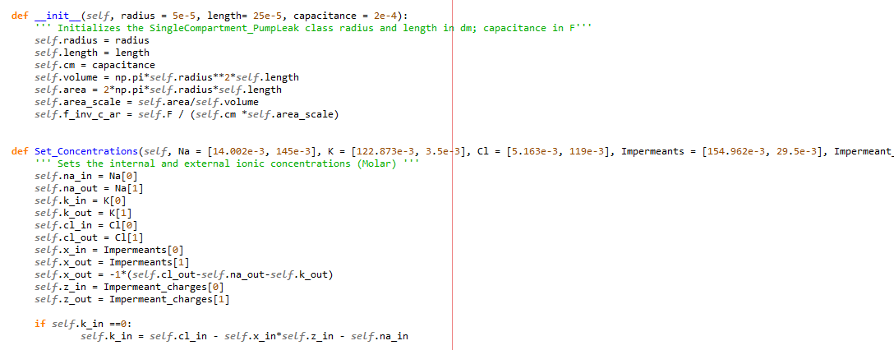
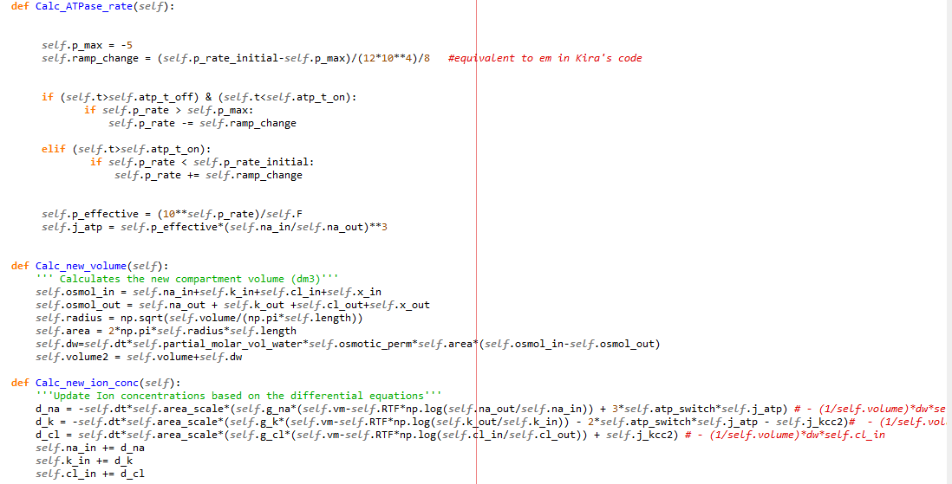
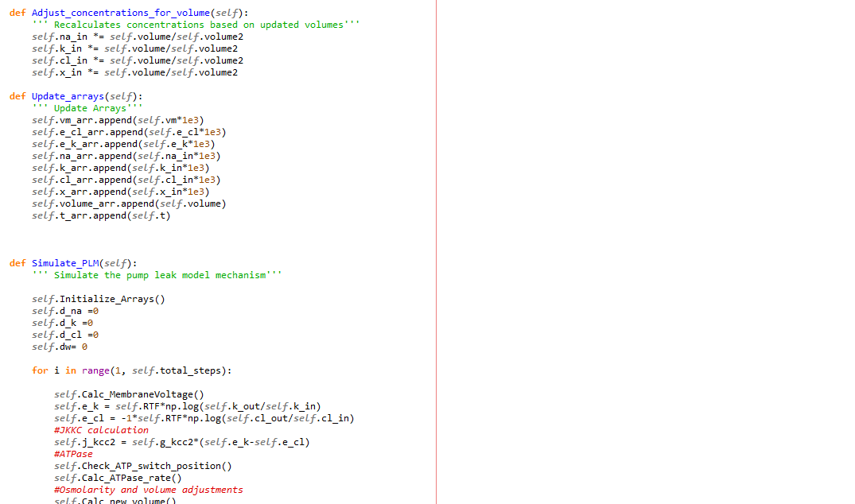
Objective 1a – single compartment model
Notes:
What does creating a single compartment computational model actually mean?
What is means is writing code in the python language that is able to simulate the dynamic interactions that occur in neurons.

Slide 38
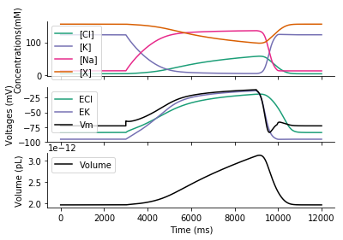
Objective 1a – single compartment model
Na-K ATPase on
Na-K ATPase off
Na-K ATPase back on
Tracking ion concentrations in a single compartment
Tracking membrane and ionic potentials in a single compartment
Tracking cell volume in a single compartment
Notes:
I created a single compartment model to replicate Kira’s finding of the importance of the Na-K ATPase. I did this by writing the code above and graphic the results. On the X axis I have time in milliseconds, and on the y axis at the top I have the intracellular concentrations of ions. For the first 3000ms the ATPase was turned on and functioning as it does in physiological states. I then turned it off and you can see the concentrations of the various ions changing. At 9000ms I turned the ATPase on and the ionic values returned to what is physiologically expected.
In objective 1b I will create a multicompartmental model which incorporates electrodiffusion.
This slide gives an insight into the kind of data that I can collect with computational modelling.
Here I am tracking the reversal potentials of the various ions and the membrane potential.
In the last frame you can see how the volume of the cell expands if the pump is switched off. This validated Kira’s work./

Slide 39
Objective 2
2) Investigate the effect of impermeant anions on the isopotential status of neurons
*Without impermeant anions
-65mV
-65mV
-65mV
-65mV
-65mV
Notes:
How will I know the model is correct?

Slide 40
Objective 2
2) Investigate the effect of impermeant anions on the isopotential status of neurons
*With impermeant anions
??????
??????
??????
??????
??????
I -
I -
I -
I -
I -
Notes:
How will I know the model is correct?

Slide 41

Objective 3
3) Investigate how excitatory or inhibitory synaptic input is modified by the presence of impermeant anions
*Without impermeant anions
+20mV
+0mV
-40mV
-65mV
Notes:
How will I know the model is correct?

Slide 42
Objective 3
3) Investigate how excitatory or inhibitory synaptic input is modified by the presence of impermeant anions
*Without impermeant anions
Current
Length of dendrite

Slide 43
Objective 3
3) Investigate how excitatory or inhibitory synaptic input is modified by the presence of impermeant anions
*With impermeant anions
??????
??????
??????
??????
I -
I -
I -
I -
I -
Notes:
How will I know the model is correct?

Slide 44
Objective 3
3) Investigate how excitatory or inhibitory synaptic input is modified by the presence of impermeant anions
?
*With impermeant anions
Current
I -
I -
I -
I -
I -
Length of dendrite

Slide 45
Objective 4
4) Investigate the influence impermeant anions have on information processing (action potential generation)
*Without impermeant anions
Voltage
Time

Slide 46
Objective 4
4) Investigate the influence impermeant anions have on information processing (action potential generation)
*With impermeant anions
?
Voltage
Time
I -
I -
I -

Slide 47
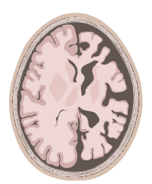
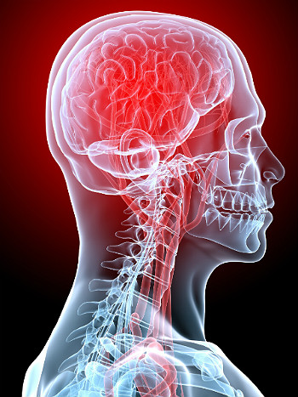
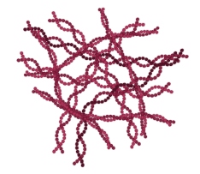

Objective 5
5) Explore how any observed effects may be relevant to disease processes
Neurodegenerative disorders
Seizures
Cerebral oedema

Slide 48
Timeline
Proposal
December 2020
Complete construction of model
April 2021
Objective 2
June 2021
Objective 3
July 2021
Objective 4
August 2021
Objective 5
September 2021
Completed thesis
December 2021

Slide 49
Take away message
Computational models of neurons provide unique insights
Current models assume fixed resting membrane voltages (isopotentiality) and don’t account for impermeant anions
These limitations impact our understanding of normal and disease states
Electrodiffusion based models incorporating impermeant anions may help address this problem

Slide 50


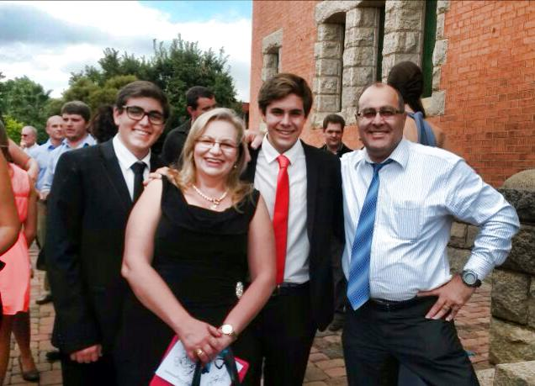


Thank you
Raimondo lab
Prof. Arieh Katz
Family, girlfriend (Sam) and friends

